Slide 1


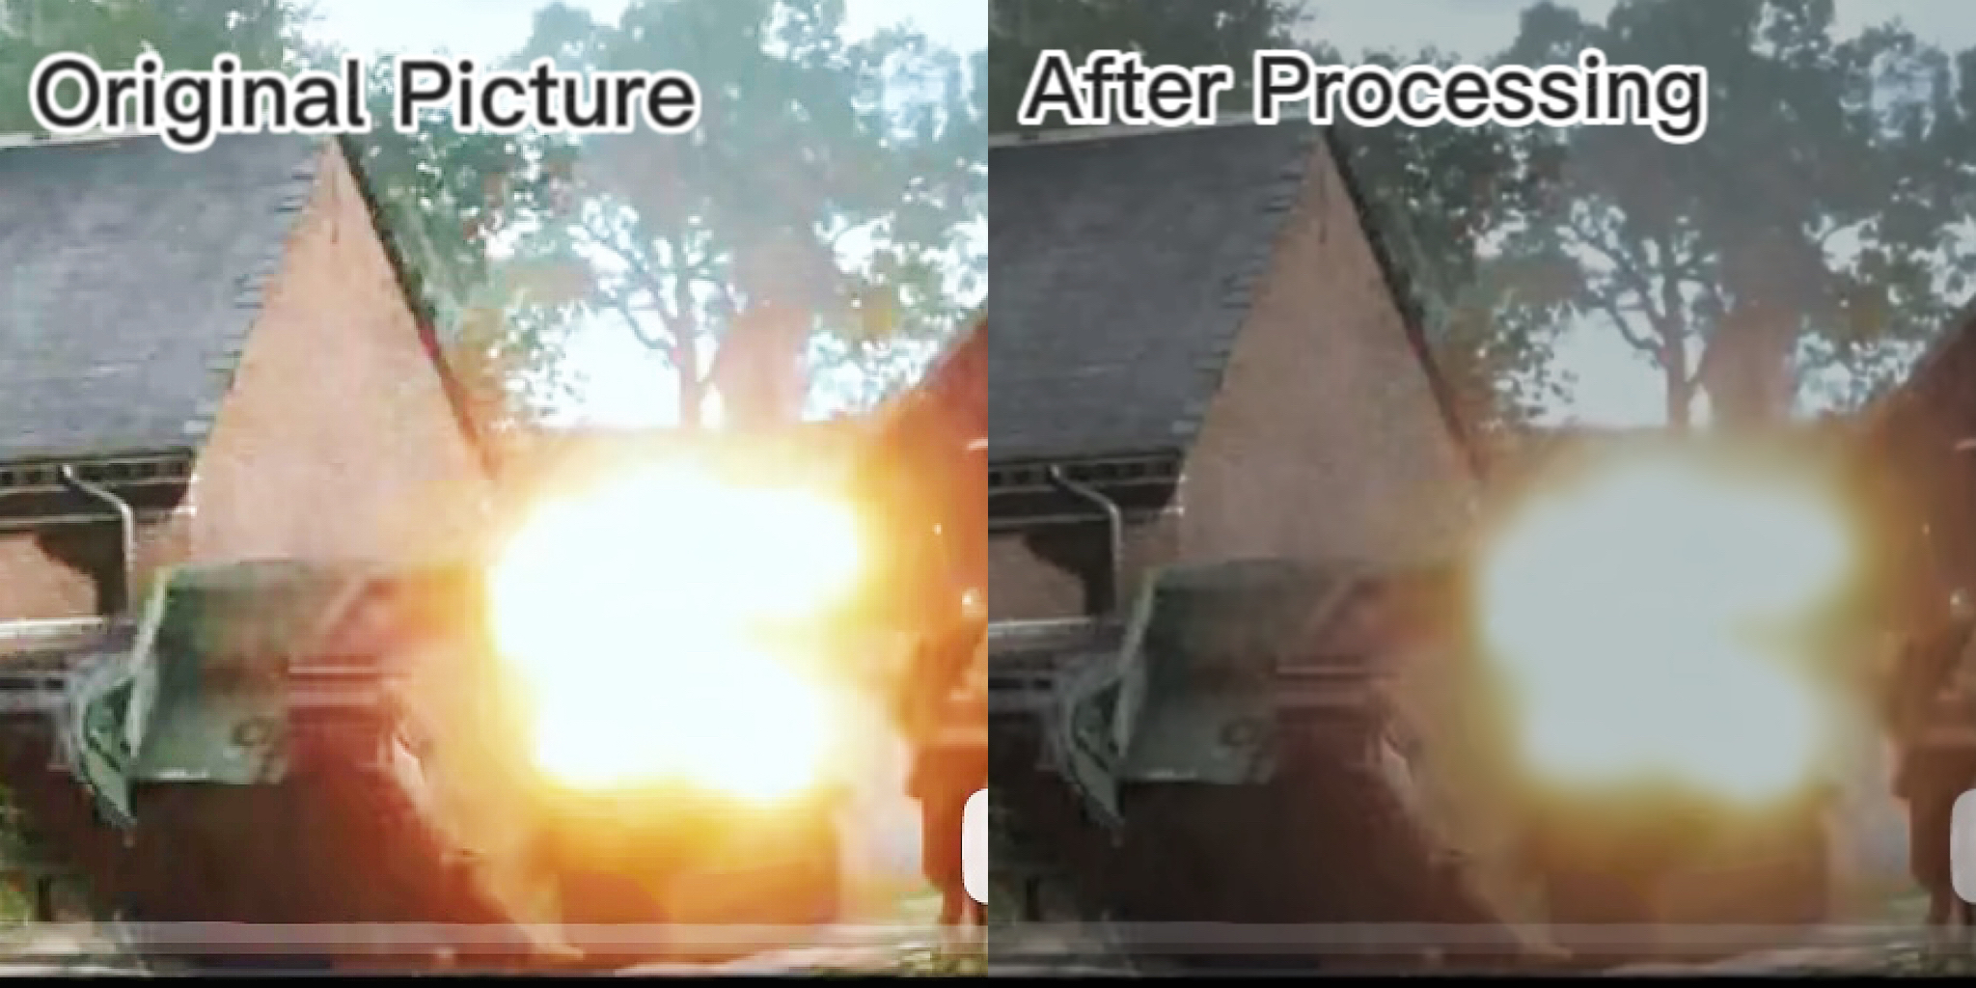
Group ID: L
Group Members: [Lu Ren 20319096] [Haorong Liang 20321126]
[Zixin Zhu 20318189] [Xingchen Tian 20319449]
Module: Coursework 3 EEEE2068 CET B (Autumn 2022-23)
Guard of Photosensitive Epilepsy (GoPE)
-- Smart Optical Processing Plugin
Introduction
Could you live without playing games, watching videos, or even using electronics for a long time? We believe it is a nightmare for most people nowadays. -- However, some people may experience generalized seizures, consciousness loss, and foaming at the mouth while playing video games or watching provocative images. It also can be fatal in severe cases. This symptom is photosensitive epilepsy (PPE) refers to seizures caused by visual stimuli such as flashing lights, high-contrast gratings, and rapid adjustment of brightness patterns. The incidence of photosensitive epilepsy was reported to be 2% in 1995 and is now greatly increased with the development of electronic technologies and game industries. Considering the high incidence and high harm of photosensitive epilepsy, to help patients maintain their health while maintaining the gaming experience, we designed a plugin -- GoPE -- to automatically adjust the refresh rate, brightness, contrast, and contour sharpness of the screen to a safe range for patients, thus lowering the risks of seizures.
Problems & Solutions
Originality & Novelty
Function 1：Reducing brightness & refresh rate. The rapid switching brightness, especially flashing light, is the main trigger of PPE. However, there are frequent muzzle flash and explosions in FPS games. The pictures of MOBA/ACT games always have rapid refresh rate and exaggerated visual effects. To reduce this kind of risk, in addition to lowering the screen’s overall brightness and refresh rates, GoPE can reduce the brightness of pixels whose brightness exceeds the safety limit. Moreover, GoPE can reduce the brightness variation to 10% of the original if a significant brightness change is detected in some local pixels of some frames.
Function 2：Reducing colour contrast. Another cause of PPE is the high contrast of pictures. GoPE can automatically reduce the luminance difference between bright and dark pixels, reducing color contrast. After processing, the frames are less bright-coloured and thus have less stimulation to patients.
Function 3：Blurring the contours. Some specific contours also are found to trigger PPE. GoPE uses high-precision detection for edges and applies Gaussian Blur algorithm to smooth images. The visual shock of sharp outlines can be significantly lessened after processing with GoPE.
Function 4: User- defined setting. Considering different users may have different needs when playing different games, GoPE allows users to set contrast, refresh rate, etc. However, to protect users’ health, all parameters cannot exceed the safety range. There is also a recommended setting for each game.
Function 5: Emergency call. GoPE can also connect to a smart bracelet via Bluetooth to monitor patients' physical condition and automatically call for help in an emergency.
Function 6: Reminder. GoPE includes a voice assistant to remind users to take rests and keep the ambient light bright.
Existing prevention of PPE is limited to wearing dark glasses and taking drugs. GoPE is the first product tailored for people with photosensitive epilepsy. It integrates the adjustment of screen parameters with various image processing. Compared with common optical adjustment apps, setting of processing parameters in GoPE has a safety limitation for patients. It is also able to automatically process the brightness of specific pixels frame by frame, thereby being more targeted to reduce the changing rate of brightness, contrast and contour sharpness of the screen. The voice reminder for regular rest plays an important role in preventing seizures. Moreover, the function of emergency calls can help unfortunate patients with a seizure receive the most timely treatment.
Pictures
Figure.1 Comparison between screen before and after processing
References [1] Bocci, T., Restani, L., Caleo, M., De Rosa, A., Rossi, S., & Sartucci, F. (2018). Platform Session – NIBS: Altered recovery from inhibitory repetitive transcranial magnetic stimulation (rTMS) in subjects with photosensitive epilepsy. Clinical Neurophysiology, 129, E227-E228. [2] 3.Sugimoto, Y., & Imaizumi, S. (2022). An Extension of Reversible Image Enhancement Processing for Saturation and Brightness Contrast. Journal of Imaging, 8(2), 27. [3] 2.Kostková, J., Flusser, J., Lébl, M., & Pedone, M. (2020). Handling Gaussian blur without deconvolution. Pattern Recognition, 103, 107264.

